Slide 1
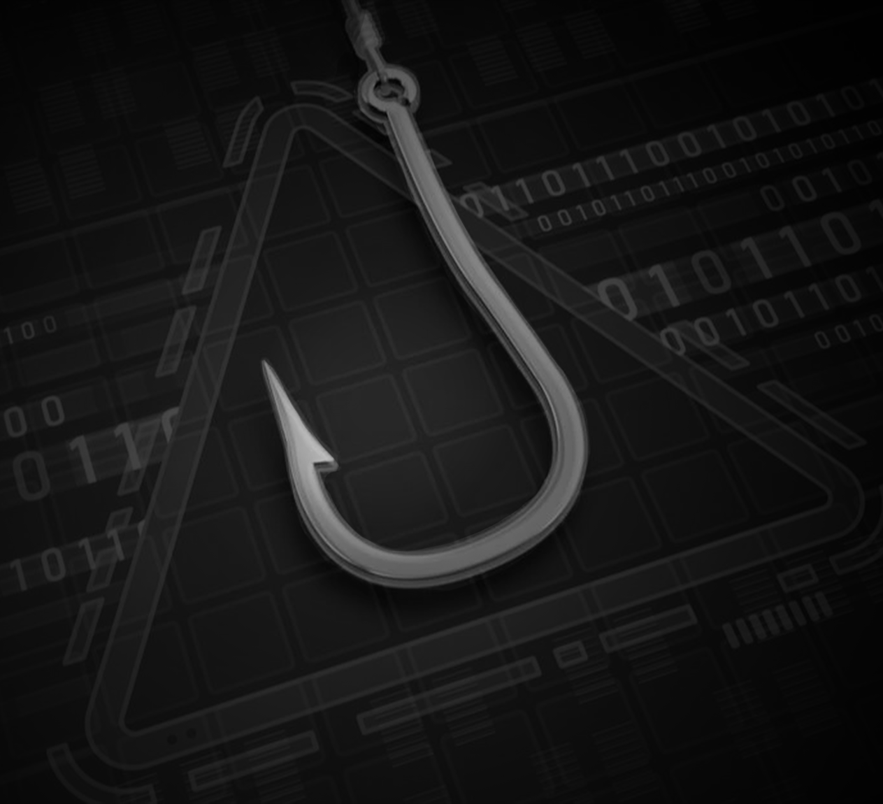
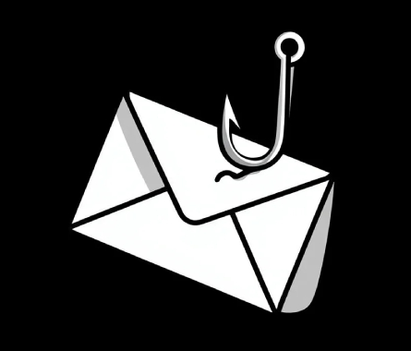
Phishing Training & Security Awareness By Amr Samir

Slide 2
Why Your Click Is The CEO's Nightmare
How to spot it
stop it
report it

Slide 3
Why Phishing Out Of All Attacks?
"90% of successful cyber attacks start with a phishing email." — Cisco 2024 Cybersecurity Report .
It targets the human, not the machine
Humans cannot be patched
One click bypasses millions in security tech

Slide 4
The Most Dangerous Attack Type statistically according to Verizon DBIR 2024
Attack Type | % of Breaches
Phishing | 90%
Malware | 5%
Password attacks | 3%
Physical attacks | 2%

Slide 5
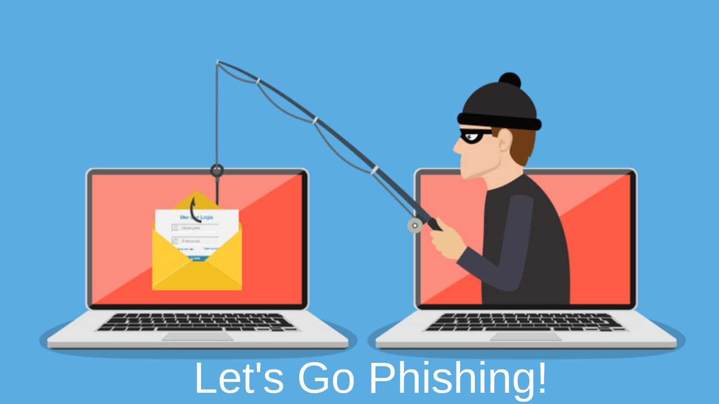
How To Recognize Phishing Emails
Generic Greetings
An immediate sign that you’re reading a phishing email comes from the greeting. Generic greetings like ‘Dear Sir/Customer’ or ‘Hello Sir/User’ are indicators of a phishing email. Legitimate organizations usually address you by your name, such as ‘Dear John.
Sender’s email
Carefully check the sender’s email. Be aware of email addresses that look similar to those of legitimate entities but have very slight differences.
Urgency
Phishing emails usually contain a sense of urgency, tricking users into taking actions without proper validation. Be cautious of emails asking you to click on a link to claim a bonus or emails claiming that your account will be suspended if you don’t take specific action.
Request for personal information
Legitimate entities never request for personal information via email like passwords, social security number, credit card information etc.
Links and attachments
Be cautious of irrelevant links or attachment in the email specially from suspicious senders. Hover over the link to see where the link leads to.
Misspellings and grammatical mistakes
Legitimate entities can generally be expected to avoid spelling and grammatical mistakes. If an email contains such errors, it is most likely a phishing email.

Slide 6
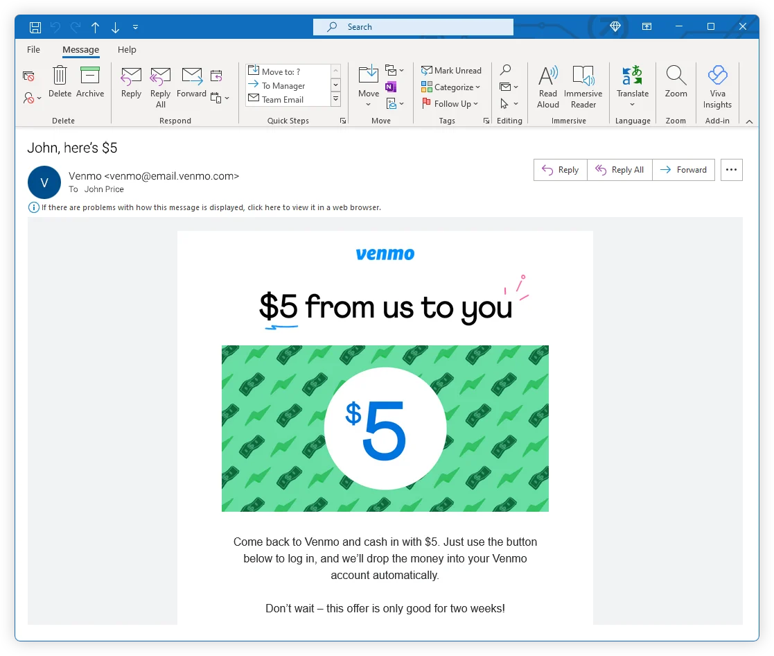
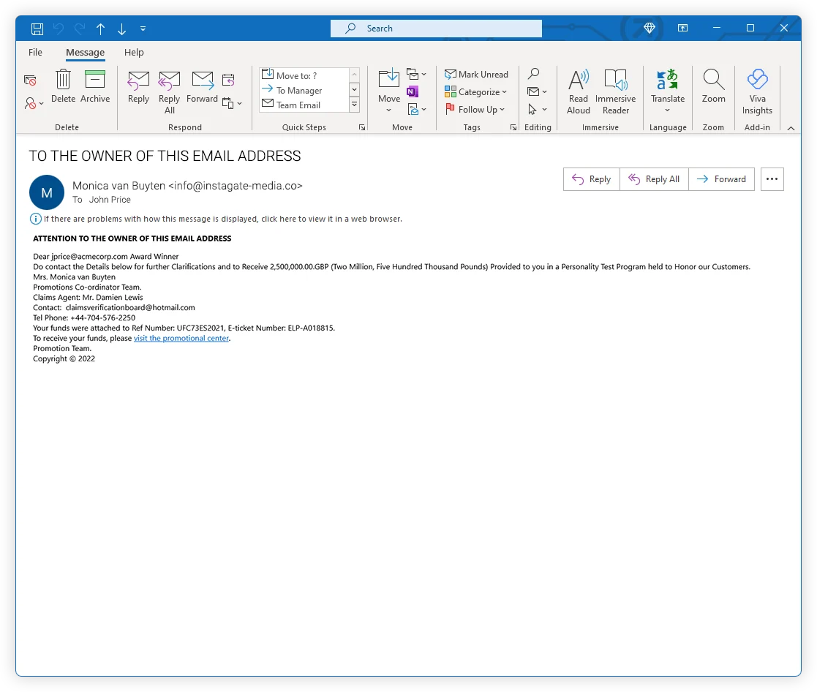
Guess the real and the phishing e-mail

Slide 7
Guess the real and the phishing e-mail
real
fake

Slide 8
What To Do When You Suspect Phishing
Step | Action
1. STOP | Do not click anything. Do not reply.
2. REPORT | Forward the email to IT security (or report button in Outlook)
3. DELETE | Delete the email. Do not open it again.

Slide 9
Quick Quiz
Question | Answer
1. The email says "Your PayPal account is suspended. Click here to verify." What do you do? | ?
2. The sender is "admin@micros0ft.com" (zero instead of o). Real or phish? | ?
3. You clicked a link by accident. No password entered. Are you safe? | ?
4. The email has the company logo and looks perfect. Can it still be phishing? | ?
5. You are 100% sure an email is phishing. What do you do? | ?

Slide 10
Quick Quiz
Question | Answer
1. The email says "Your PayPal account is suspended. Click here to verify." What do you do? | Report and delete. Open PayPal directly in browser, not the link.
2. The sender is "admin@micros0ft.com" (zero instead of o). Real or phish? | Phish. Domain is wrong.
3. You clicked a link by accident. No password entered. Are you safe? | No. Malware can download without password. Disconnect from network and tell IT.
4. The email has the company logo and looks perfect. Can it still be phishing? | Yes. Attackers copy logos exactly.
5. You are 100% sure an email is phishing. What do you do? | Report it. Do not delete without reporting.

Slide 11
Cybersecurity is not just the IT team's job. It is every single person in this room.
Stay safe , thank you

